Slide 1
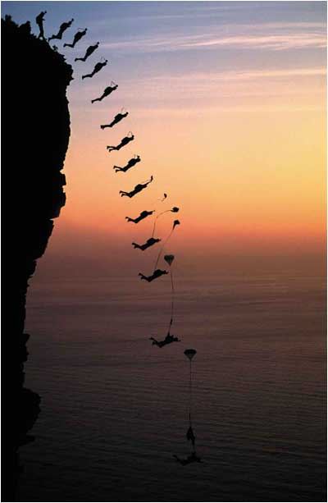
Acceleration due to Gravity
This lesson will focus on how objects accelerate under the influence of gravity
You will learn that all objects near the surface of the Earth accelerate at the same rate regardless of their mass

Slide 2
Learning Goals
By the end of this lesson, you will be able to:
define free fall
show that falling objects accelerate at the same rate regardless of their mass
solve motion related problems involving falling objects

Slide 3
Success Criteria
Can I:
define free fall
show that all objects accelerate at the same rate regardless of their mass
solve kinematic problems involving falling objects

Slide 4
acceleration due to gravity
acceleration due to gravity is the acceleration of an object when it is allowed to fall freely
the acceleration due to gravity is 9.8 m/s² near the surface of the Earth, the symbol is g
the acceleration due to gravity is not dependent on mass – a 1 kg object will accelerate at the same rate as a 1000 kg object, 9.8 m/s²
free fall is the acceleration due to gravity of an object in the absence of air resistance

Slide 5
Sample Problem
A base jumper with a mass of 75 kg falls from a cliff of height 352 m. What is her speed after free falling for 6.0 s?
Sol’n:
v_{i} = 0.0 m/s
a = 9.8 m/s² [D]
= – 9.8 m/s²
Δt = 6.0 s
v_{f} = ?
∴ The base jumpers speed after 6.0 s is 60. m/s

Slide 6
Sample Problem
What if the base jumper were to leap from the cliff with an initial vel of 5.0 m/s [U]. What is her velocity after 6.0 s?
Sol’n:
The base jumpers velocity after 6.0 s is 54 m/s [D]

Slide 7
Sample Problem
What if the base jumper were to let go of her keys as she leaped from the cliff. How long would it take for the keys to hit the ground?
Sol’n:
this is a quadratic equation and must be solved using the quadratic formula

Slide 8
∴ the keys will hit the ground 9.0 s after they are dropped

Slide 9
HOMEWORK
Read Section 1.6
Review Tutorial 1 and 2
Questions 1 – 2 pg 41
1 – 2 pg 42
1 – 7 pg 43

